Slide 1
Other types of networks and some example applications
Anders Krogh

Slide 2
Many different types of neural networks used for different tasks

Slide 3
Generative models

Slide 4
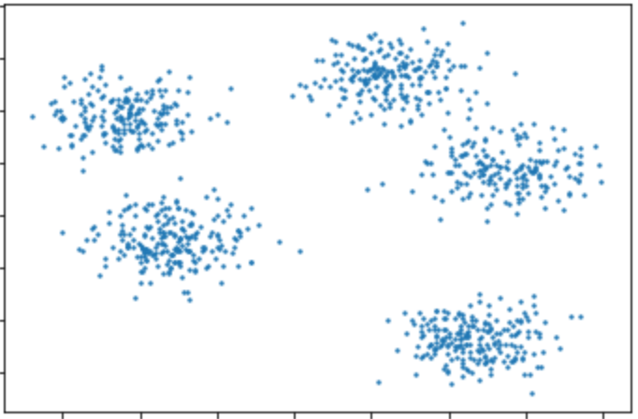
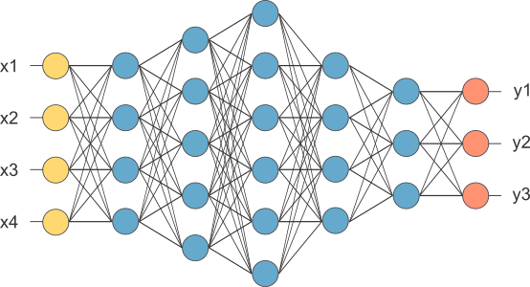
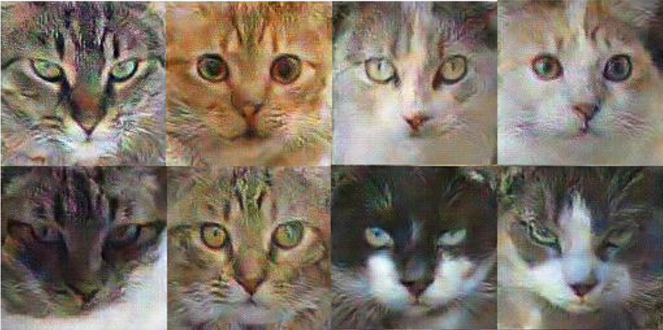


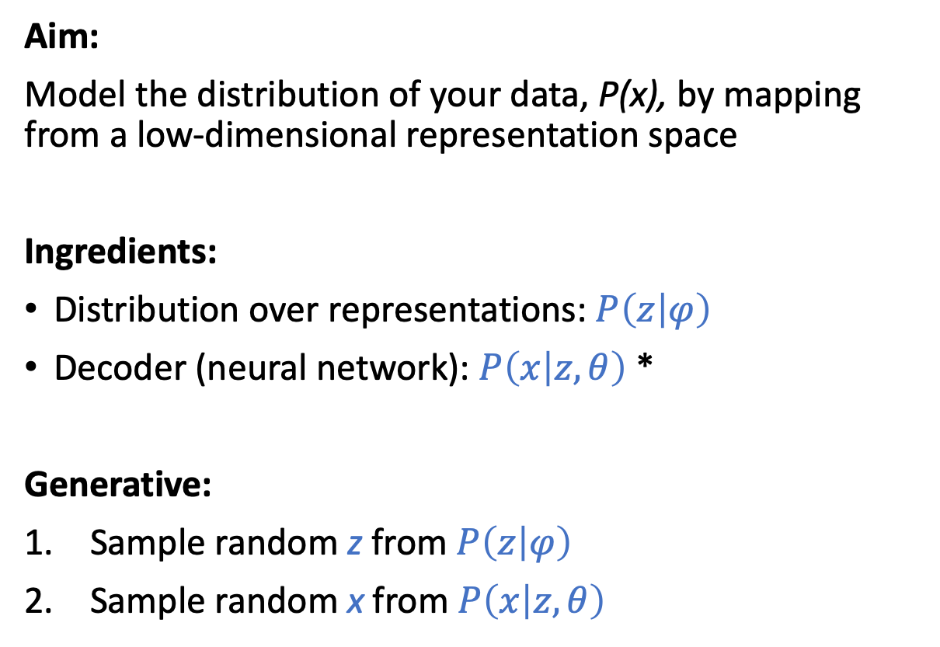

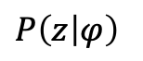

Generative neural networks
Low dimensional representation space
Aim:
Model the distribution of your data, P(x), by mapping from a low-dimensional representation space
Ingredients:
Distribution over representations: $P\left(z | φ\right)$
Decoder (neural network): $P\left(x | z,θ\right)$ *
Generative:
Sample random z from $P\left(z | φ\right)$
Sample random x from $P\left(x | z,θ\right)$
$$z$$
$P\left(z | φ\right)$
$$θ$$
$$P\left(x | z,θ\right)$$
$$x$$
*) Neural network may for instance output a mean of a normal with fixed variance
High dimensional data space

Slide 5
Why generate images of fake cats?
Learned 2D representation of images of handwritten digits
Model learns a low dimensional representation
Related to manifold learning
UMAP
tSNE
This may be useful for other puposes
Representations useful for other tasks
Grouping of tumor types, stocks, cats,…
Imputation
Interpolation
Images from MNIST

Slide 6
Latent space interpolation
Copied from
“Generative Modeling with Variational Auto Encoder (VAE). Understanding the intuition behind Variational Autoencoder”
By Fathy Rashad
https://medium.com/vitrox-publication/generative-modeling-with-variational-auto-encoder-vae-fc449be9890e
Similar: App that can predict how you will look when you get old

Slide 7

VAE: Variational Autoencoder
Training of generative models require additional “tricks”
One method is to train an encoder together with the decoder to give a distribution P(z|x) to sample from
This is called a variational autoencoder
Generative adversarial network (GAN) is another type
Image credits: https://en.wikipedia.org/wiki/Variational_autoencoder, EugenioTL, https://commons.wikimedia.org/wiki/User:EugenioTL

Slide 8
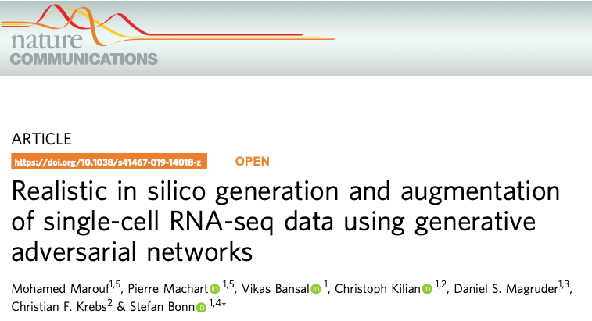
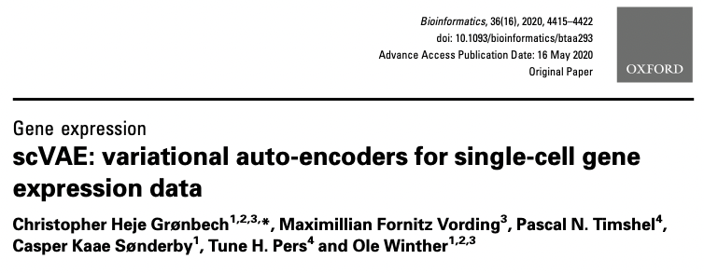
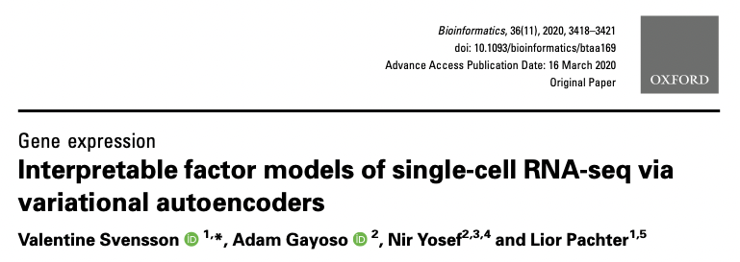
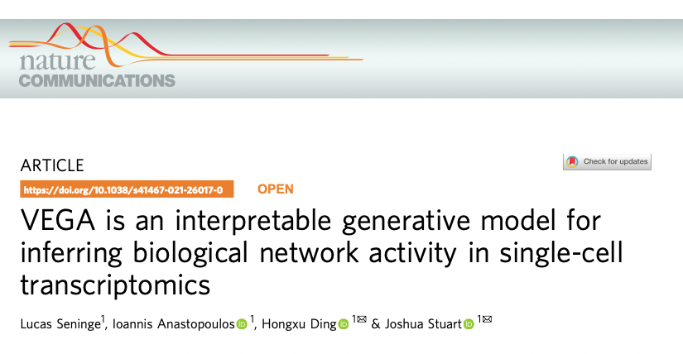
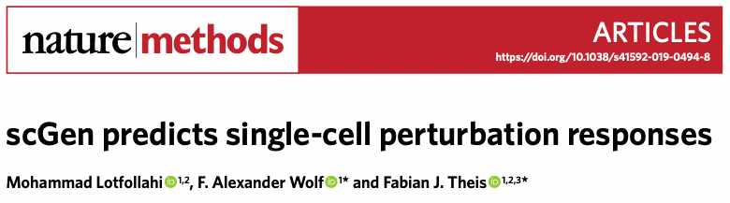
Generative models for gene expression

Slide 9
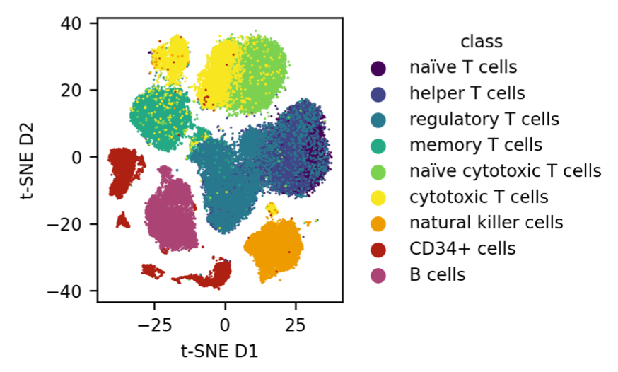
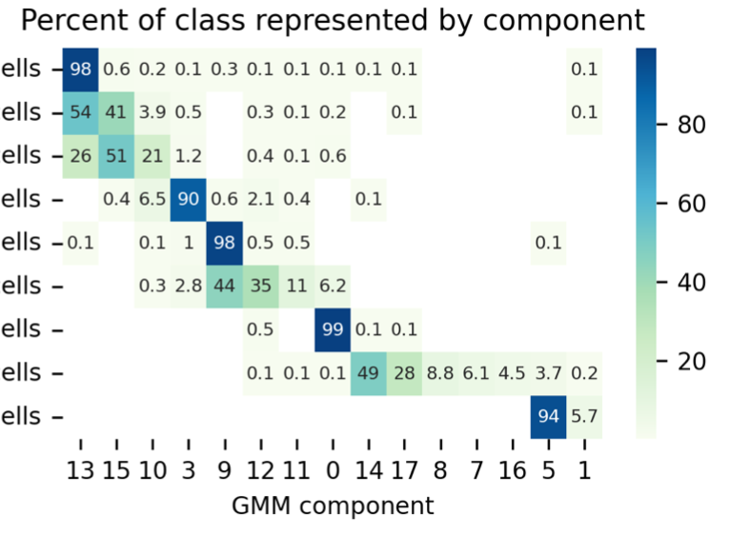
A Deep Generative model applied to a single-cell dataset from peripheral blood mononuclear cells*
*) Data from Zheng, et al. Nat Commun. 2017 Apr;8(1):14049. https://doi.org/10.1038/ncomms14049.
Schuster & Krogh: https://arxiv.org/abs/2110.06672

Slide 10
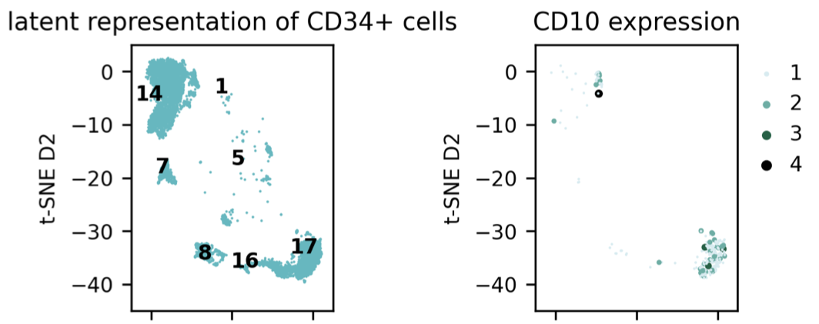
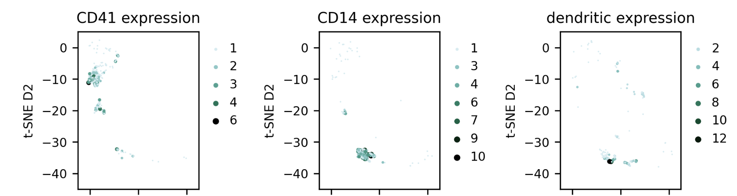
Sub-clustering for marker genes
Heatmaps shows expression count

Slide 11
Transformers

Slide 12
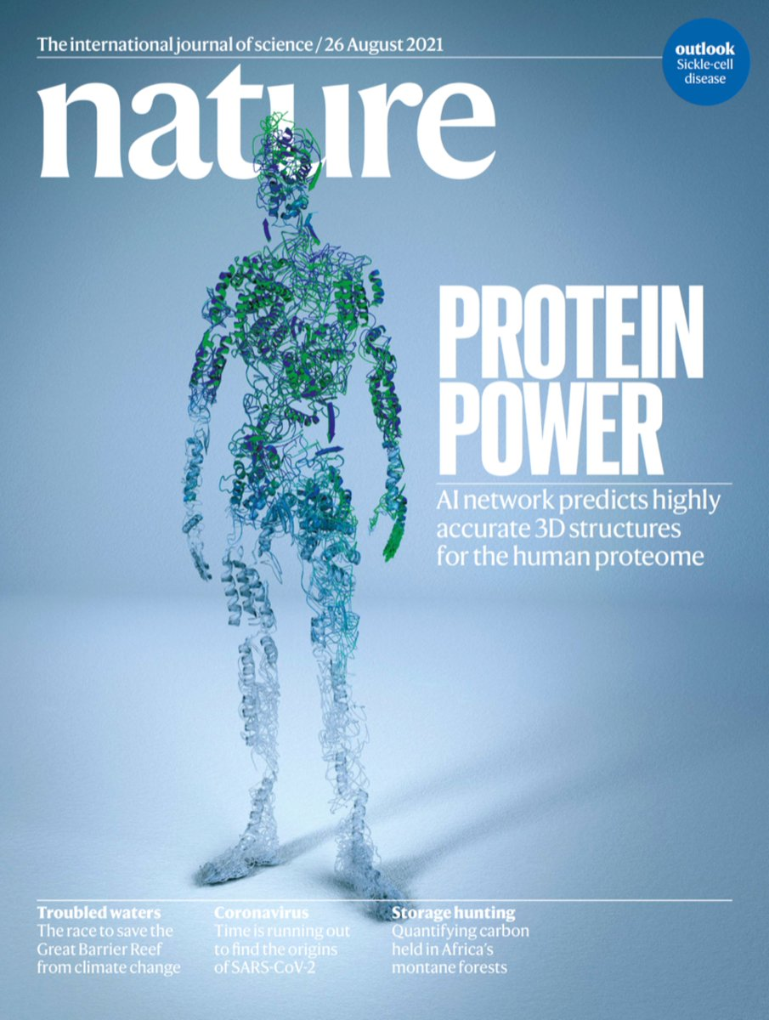
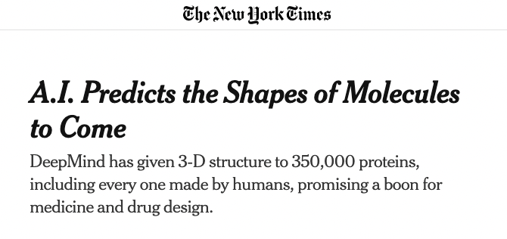
AlphaFold 2

Slide 13
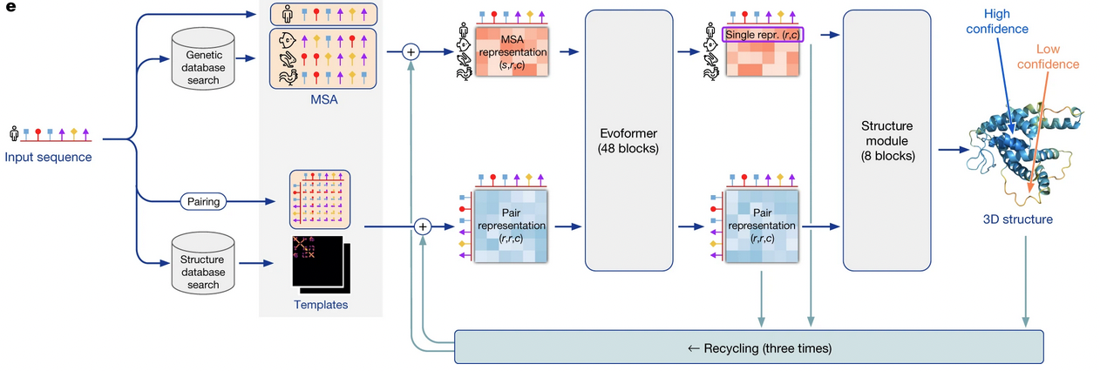
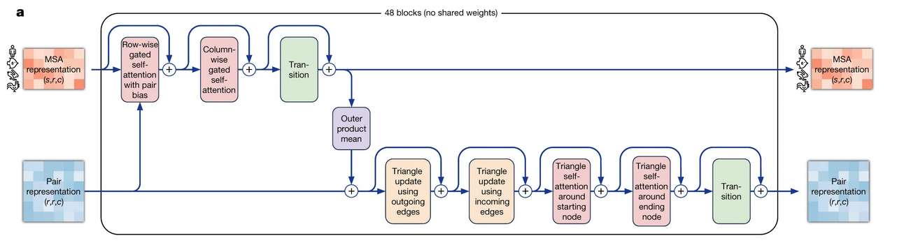
From: Jumper, J., Evans, R., Pritzel, A. et al. Highly accurate protein structure prediction with AlphaFold. Nature 596, 583–589 (2021). https://doi.org/10.1038/s41586-021-03819-2

Slide 14
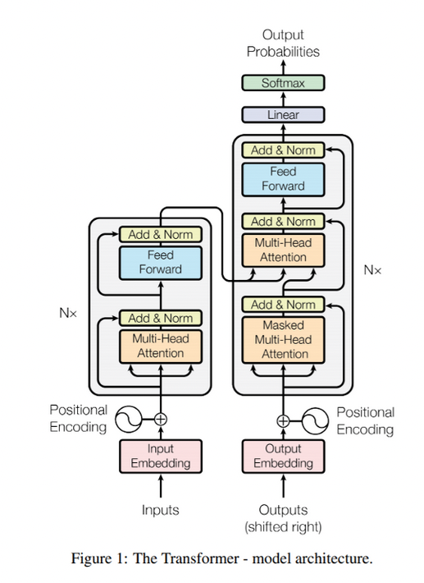
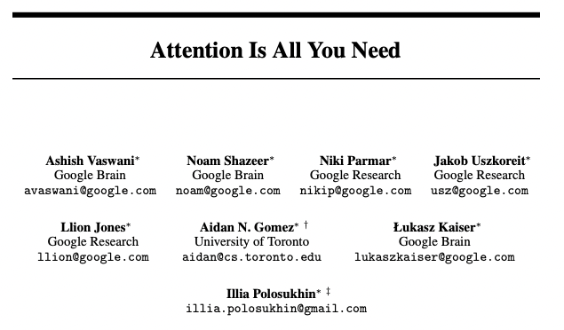
Transformer Neural Networks
Introduced for natural language processing
Used for sequential data like words in a sentence or amino acids in a sequence
Replaces recurrent neural networks
Use several layers of representations and an attention mechanism to focus on important parts (words)
Learn more e.g. in this blog post (where the figure is from):
https://towardsdatascience.com/transformer-neural-network-step-by-step-breakdown-of-the-beast-b3e096dc857f
or read the paper
31st Conference on Neural Information Processing Systems (NIPS 2017), Long Beach, CA, USA.

Slide 15
And so on
DELL-E https://openai.com/dall-e-2/
ChatGBT

